Slide 1
Internal UAT

Slide 2
Set Up
Approached 10 SMU student to try our app
Feedbacks are taken
url: https://docs.google.com/a/smu.edu.sg/forms/d/1wZYzfP2ARKzY_5BCwP7xqCmX3pr-x38eneDK4j9hWgQ/viewform
responses:
https://docs.google.com/a/smu.edu.sg/spreadsheet/ccc?key=0Ais3uT1M_-X_dFBjNFhMNGlhWWJwaFRiVGwybGpxR1E&usp=drive_web#gid=0

Slide 3
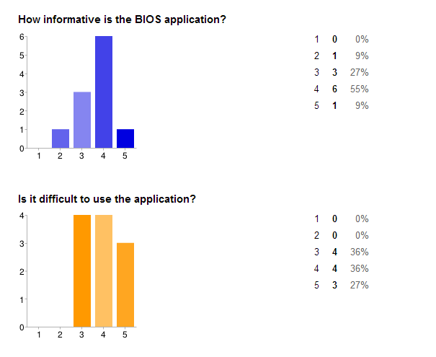

Slide 4
Feedbacks – Login page
Job Well Done
Simple
Clear
Straight forward

Slide 5
Feedback – User Info
Job Well Done
Easily accessible
Simple and clear
Areas of Improvement
Not much info given about the student
Bigger icon/ change to “profile info”
Put the completed mod beside the bid button
Include total CU bid and enrolled

Slide 6
Feedback – Timetable
Job Well Done
Intuitive
Areas Of Improvement
Include name of mod
Clean colour coding for different modules could be set
State the name of prof
Include the week

Slide 7
Feedback – Search Course
Job Well Done
Simple
Areas Of Improvement
Better if there is a tab for each school’s mod
Show more courses per page
Better if there is filter function
Checkbox to hide non biddable mods and completed mods

Slide 8
Feedback – Update/ Delete Bid
Job Well Done
Convenient
Areas Of Improvement
Include name of mod, prof etc.

Slide 9
Other comments
Job Well Done
User friendly and easy to access
Areas Of Improvement
App is laggy
Limited functions
Show a section straightaway for biddable mods and non biddable mod which includes the pre-requisites to the courses and state none if there isn’t any

